Slide 1


Residual Analysis
Notes:
Residual Analysis is an important step for validating a linear regression model. This presentation introduce the main steps involved in residual analysis and shows their implementation in R.

Slide 2
Residual Analysis
Residual is the difference between the actual y values and the predicted values.
Reflects the error of the regression line at any given point.
Notes:
If you recall, the difference between the observed value of the dependent variable (y) and the predicted value (ŷ) is called the residual. Each data point has one residual. Ideally all residuals should be small and unstructured; if so this would mean that the regression analysis has been successful in explaining the essential part of the variation of the dependent variable.

Slide 3
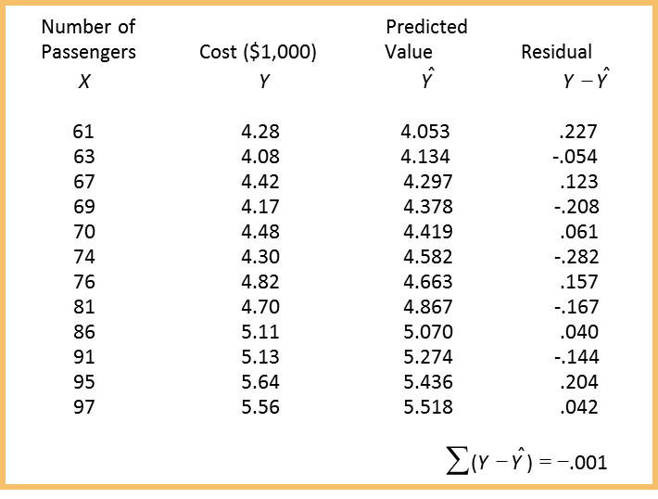
Residual Analysis: Airline Cost Example
Notes:
15
Let’s consider, again, the example that we discussed previously. In this case we tried to estimate the cost of the flight based on the number of passengers. So the x column would be the number of passengers and the y column would be the cost and once the model is constructed, we can calculate the predicted values of Y, shown as Y hat. The residuals are obviously defined as the difference between Y and Y hat, so for every single data point you can see the calculated residual for that particular data point. Towards the end, we can see the sum of all the residuals. Ideally, we want all the residuals to be symmetric around zero, meaning that the sum of the residuals should be around zero, which in this case we can see is equal to -.001.

Slide 4
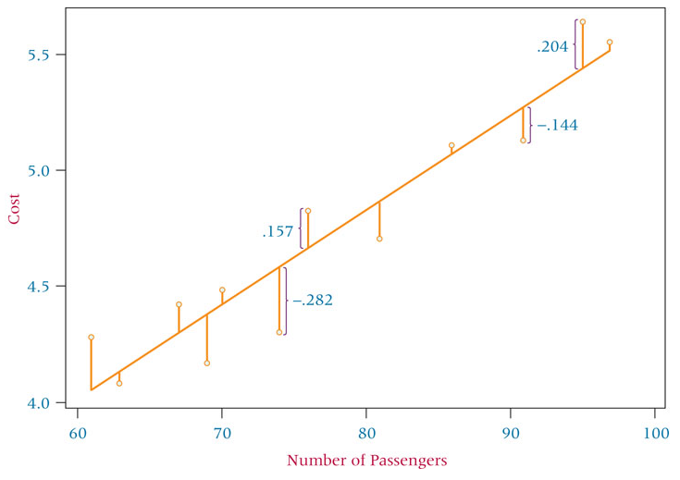
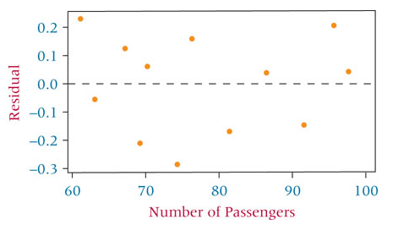
Residual Analysis for Number of Passengers
Outliers: data points that lie apart from the rest of the points. They can produce large residuals and affect the regression line.
Notes:
this slide shows the visual representation of the residuals. As we can see, for each of the data points, the residual is shown on the graph. On the right-hand side, we can see the residuals against the number of passengers, Ideally, there should be no structure or pattern in the shape of the residuals. Also, as you recall, outliers can be defined as the data points that lie apart from the rest of the points. In the case of an outlier, the residual can be very high and looking at the residual pattern, is actually one way to detect potential outliers.

Slide 5
Using Residuals to Test the Assumptions of the Regression Model
The assumptions of the simple linear regression model
The model is linear
The error terms have constant variances
The error terms are independent
The error terms are normally distributed
Notes:
If residuals exhibit a structure or present any special aspect that does not seem random, it sheds a "bad light" on the regression. Most problems that were initially overlooked when diagnosing the variables in the model or were impossible to see, will, turn up in the residuals. For example, if the linear model is not a good fit, the error terms may show to have a pattern or may not have a constant variance over the fitted values. Particularly, we want the error terms to have constant variance, be independent of each other and be normally distributed.

Slide 6
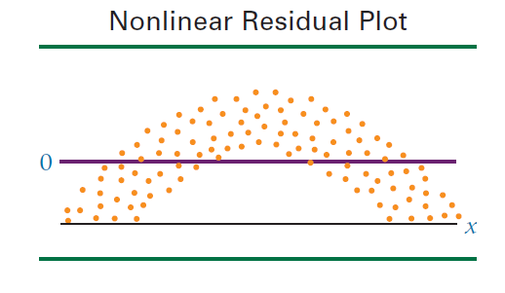
Using Residuals to Test the Assumptions of the Regression Model
Notes:
this slide shows an example where there is a particular pattern in the shape of the residuals. We can conclude that the choice of linear model was not the best in this case.

Slide 7
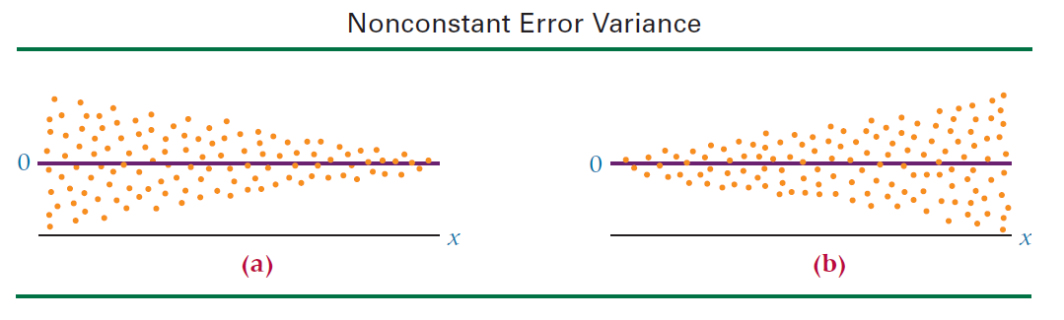
Using Residuals to Test the Assumptions of the Regression Model
Notes:
Two other examples are shown in this slide, where as we can see the variance of the error is not constant. The first case shown on the left hand side, the variance of the error terms start to decrease as X increases. On the other graph on the right hand side, variance increases as X increases. In any case, as long as the variance of the error terms are not constant, the linear model does not seem to be the best choice.

Slide 8
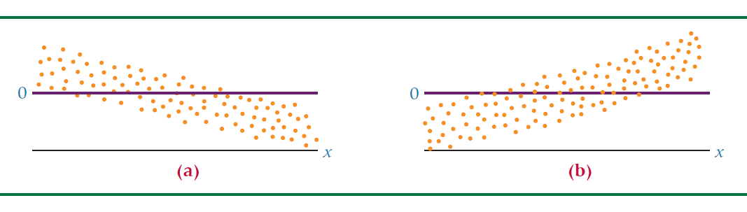

Using Residuals to Test the Assumptions of the Regression Model
Notes:
Other examples are shown in this slide. As we can see in here, the value of the error term is dependent on the value of X. On the case on the left-hand side, the value of error is decreasing as X is increasing, and in contrary on the right-hand side, we can see that the error terms start to increase as X is increasing. As long as we can see a pattern, where error term is dependent on the value of X, we can conclude that the choice of the linear model was not the best.

Slide 9
Standard Error of the Estimate
Residuals represent errors of estimation for individual points.
A more useful measurement of error is the standard error of the estimate.
The standard error of the estimate, denoted se, is a standard deviation of the error of the regression model.
Notes:
The standard error of the estimate is a measure of the accuracy of predictions. Recall that the regression line is the line that minimizes the sum of squared deviations of prediction (also called the sum of squares error). The standard error of the estimate, denoted se, is the standard deviation of the error of the regression model.

Slide 10
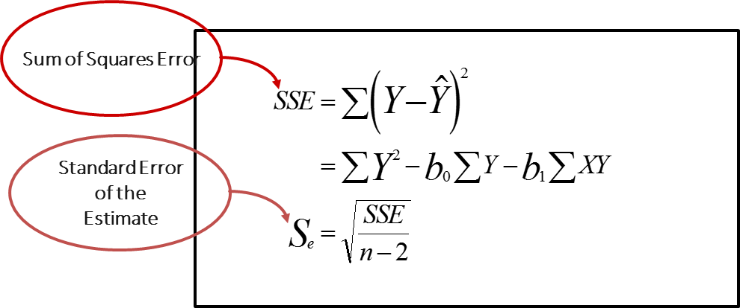
Standard Error of the Estimate
Notes:
22
The analytical formulation of the standard error of the estimate is shown in this slide. As we can see some square of the error is defined as the sum of the deltas between the actual values of the Y and the estimated values of Y shown as Y hat. So this delta is taken to part two, and then we sum all of the delta values, and that would be the sum of the square of the errors. The standard error of estimate would be the square root of the SSE divided by the number of observations minus two.

Slide 11
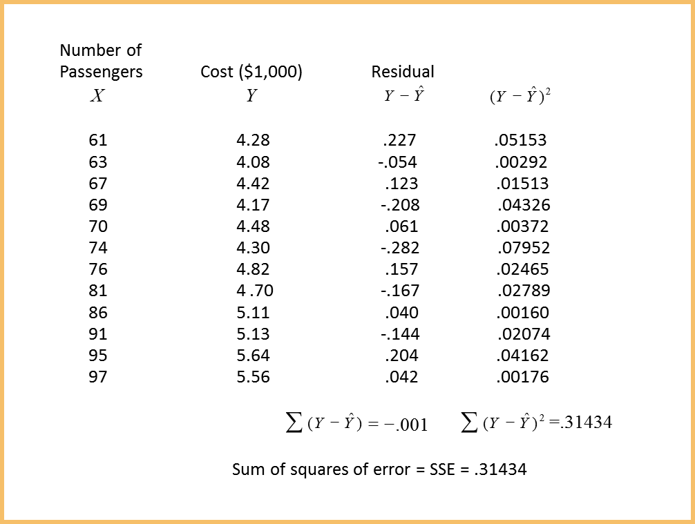
Determining SSE for the Airline Cost Example
Notes:
Let’s have a look at the example in here. In this slide, we are trying to determine the SSE for the Airline Cost Example. The number of passengers is given as X, and the cost of flight is given as Y in thousands of dollars. So for each variable, Y, the predicted value of Y is shown as Y hat, and the residual is shown as the difference between Y and Y hat. So, the residual column shows the delta of the estimated value of Y, Y hat, and the actual value of Y for all the values. These values are then taken to part two as you can see on the right column. The sum squares of the errors, SSE is equal to 0.31434 in this example.

Slide 12
Standard Error of the Estimate for the Airline Cost Example
Sum of Squares
Error
Standard Error of the
Estimate
Notes:
24
Once the SSE is calculated, the standard error of estimate, or SSE can be easily calculated by taking SSE and dividing it by the number of observations minus two and calculating the square root of that value. So in this case the square root of the 0.3143 divided by ten is equal to 0.1773 which is the standard error of estimate in this example.

Slide 13
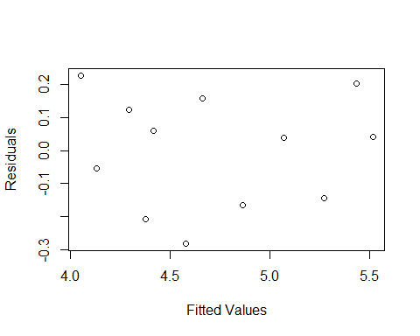
Example
Passengers=c(61,63,67,69,70,74,76,81,86,91,95,97) Cost=c(4.28,4.08,4.42,4.17,4.48,4.3,4.82,4.7,5.11,5.13,5.64,5.56) Model=lm(Cost ~ Passengers) summary(Model)$sigma #Standard error of the model ## [1] 0.1772175 sqrt(sum(Model$residuals^2)/(length(Cost)-2)) ## [1] 0.1772175 plot(Model$fitted.values, Model$residuals, xlab="Fitted Values", ylab="Residuals")
Notes:
24
Let’s have a quick look at the implementation the example in R. Here, first we need to define the passengers and cost as two variables. In this case we have passengers, and then we have to combine operator and then we can define the values of the passengers and the number of passengers 61, 63 and etc. Then the cost variable is defined as the cost of flight in thousands of dollars. And then we want to build a linear model, so we use the lm function, so we have model is equal to lm cost against passengers. Then we can get a summary of the model. Also, we can specifically ask for specific attributes of the summary of the model. In this case, we can look at the sigma, which is the standard error of the model. Note that the hashtag results in the rest of the line to be considered as common and is shown in brown color so we can use hashtags to provide comments to know what a piece of code is doing, and hence the readability of the code. In this case, as we can see, the sigma is equal to 0.177, which is the same value that we calculated before, so we also can calculate this value standard error differently, so we can calculate it as the square root of the residuals, so we can say square root of the sum of the model residuals part two divided by the length of the data, which is the length of the cost minus 2. This is basically the same result as 0.177. We can also plot the fitted values against the residuals, so we can also say plot model$ fitted values, so fitted values in this case would be the Y hat values, the values that have been predicted. And we can basically plot the residuals against the fitted values. The X label shows the label for the horizontal axis. The Y label shows the value of the label for the vertical access. So, we have the fitted value for X axis and residual values for the Y axis, and as we can see, there is no particular patterns when we show the residuals in this case, which is a good sign.

Slide 14
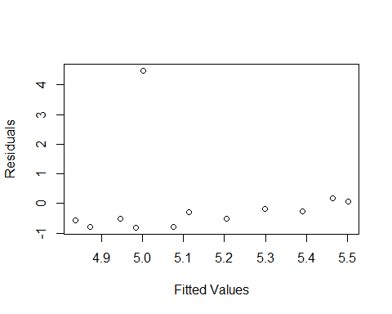
Example
Passengers=c(61,63,67,69,70,74,76,81,86,91,95,97) Cost=c(4.28,4.08,4.42,4.17,9.48,4.3,4.82,4.7,5.11,5.13,5.64,5.56) Model=lm(Cost ~Passengers) plot(Model$fitted.values, Model$residuals, xlab="Fitted Values", ylab="Residuals")
Outlier
Notes:
24
Let’s consider the previous example but change one of the cost values to 9.48. So, in this case as we can see, the value is too high, and this can be considered as an outlier. So, when we build a model and plug the model residuals against the fitted values, we can see one value is far from all other values. This is the outlier and it’s because this particular data point was far from the actual line. Therefore, we can see the effect of this as an outlier. In fact, residual and error analysis can be used to detect potential outliers in a data set in regression analysis.

Slide 15
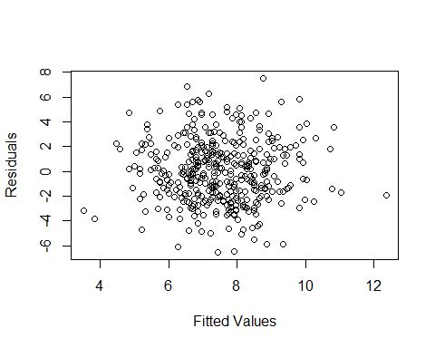
Example
library(ISLR) Model=lm(Sales ~ Price, data=Carseats) plot(Model$fitted.values,Model$residuals, xlab="Fitted Values", ylab="Residuals")
Notes:
24
Let’s consider another example. In this case we want to predict the sales of the car seat, based on the price of the car seats. Both of these variables belong to a data frame called car seat which is a part of the ISLR library. We first load the ISLR library by calling the library ISLR. And in this case we can say model is equal to lm against price, and then we say data is car seat, meaning that both of these columns belong to a data frame called car seat which is loaded when ISLR library is loaded. Once we have the model, we can plot the residuals against the fitted values. As we can see in here, we cannot really see any particular pattern, so it looks like the choice of linear model is a good choice for predicting the sales against the price.

Slide 16
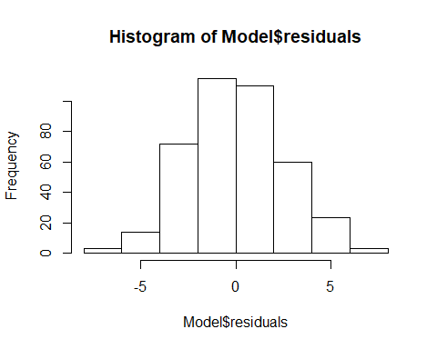
Example
hist(Model$residuals)
Notes:
24
We can also examine the histogram of the model residuals. We can use the command hist and provide the model$residuals to plug the residuals of the models. In these cases we can see the residuals seem to have a symmetric distribution and it looks like a bell shaped normal distribution which is what we want.

Slide 17
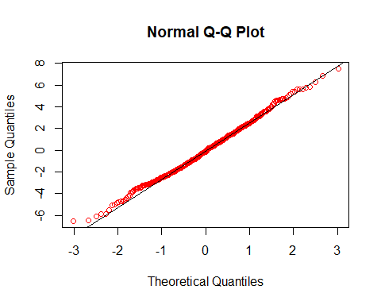
Example
qqnorm(Model$residuals,col="red") qqline(Model$residuals)
Notes:
24
Why plotting the histogram might be useful, a more formal way of examining the distribution of the residuals is to use the Q-Q norm and Q line plots. So, the normal Q-Q plot compares the distribution of given numbers, in this case is the residuals against the theoretical quantiles of normal distribution. So in this case we can say Q-Q norm model residuals and we can define the color as red and can basically plot the theoretical line as Q-Q line model&residuals. As we can see, on the X-axis we have the theoretical quantiles and on the Y-axis, we have the sample quantiles. From the result we can see that there is a good match between the theoretical and sample distribution, which suggest the residuals follow a normal distribution as we were expecting.

